Slide 1
Mobile – Android Intro
IBM EcoD

Slide 2




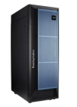



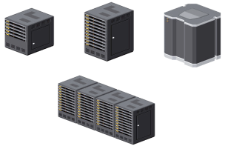
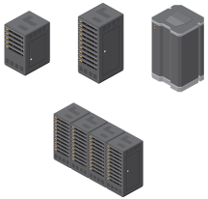

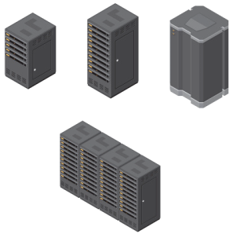
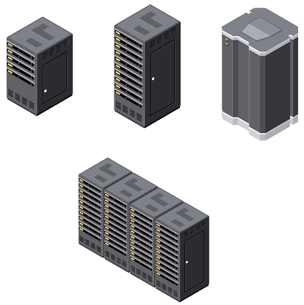











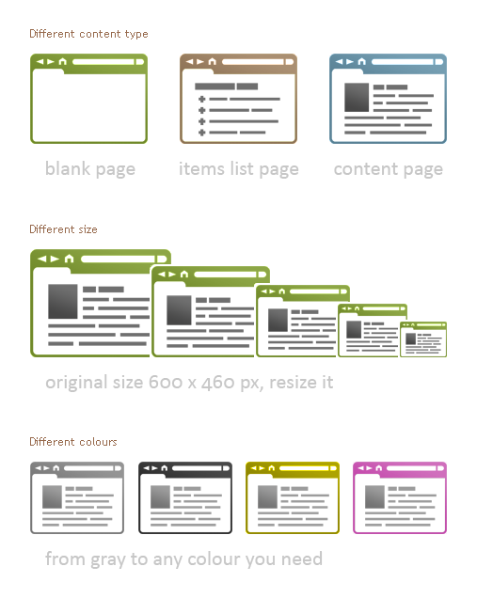

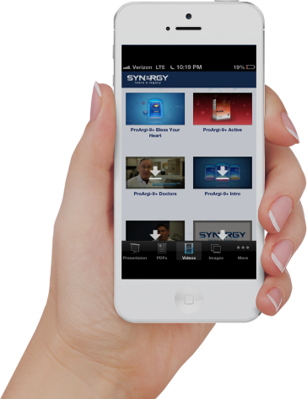
Mobile Cloud = Bringing the Real Power of CAMSS
Customer’s energy around CAMSS is not driven by 5 distinct parallel agendas
Combining CAMSS in tandem delivers agility to create new business opportunities
API-centric approach enable CAMSS to be rapidly composed as building blocks
C
+
A
+
M
+
S
+
S
Hybrid cloud
Real-time big data analytics
Mobile &
Internet of Things
Social Engagement
Perimeter Security
SaaS
API
API
API
API
API
API
API
e.g. Developer composes new app to address requirement from CMO
Mobile app drives increased retail sales by analysis (SaaS) of purchase history (on prem), shopping basket (cloud) and preferences of social circle and sends secure personalised offers based on proximity to stores and vending machines (Internet of Things)
Notes:
2

Slide 3
What is Android?
A software stack for mobile devices that includes
An operating system
Middleware
Key Applications
Uses Linux to provide core system services
Security
Memory management
Process management
Power management
Hardware drivers

Slide 4
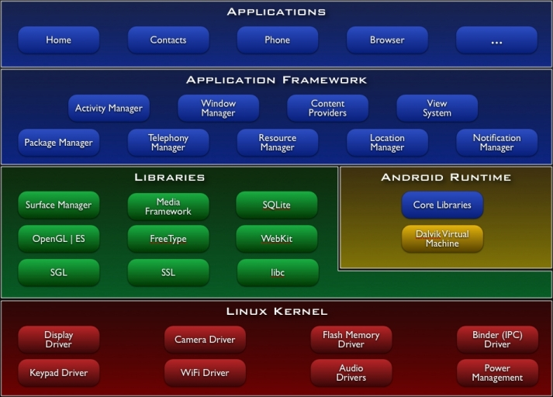
http://developer.android.com/guide/basics/what-is-android.html

Slide 5
Android Features
Application framework enabling reuse and replacement of components
Dalvik virtual machine optimized for mobile devices
Integrated browser based on the open source WebKit engine
Optimized graphics powered by a custom 2D graphics library; 3D graphics based on the OpenGL ES 1.0 specification (hardware acceleration optional)
SQLite for structured data storage
Media support for common audio, video, and still image formats (MPEG4, H.264, MP3, AAC, AMR, JPG, PNG, GIF)
GSM Telephony (hardware dependent)
Bluetooth, EDGE, 3G, and WiFi (hardware dependent)
Camera, GPS, compass, and accelerometer (hardware dependent)
Rich development environment including a device emulator, tools for debugging, memory and performance profiling, and a plugin for the Eclipse IDE
http://developer.android.com/guide/basics/what-is-android.html

Slide 6
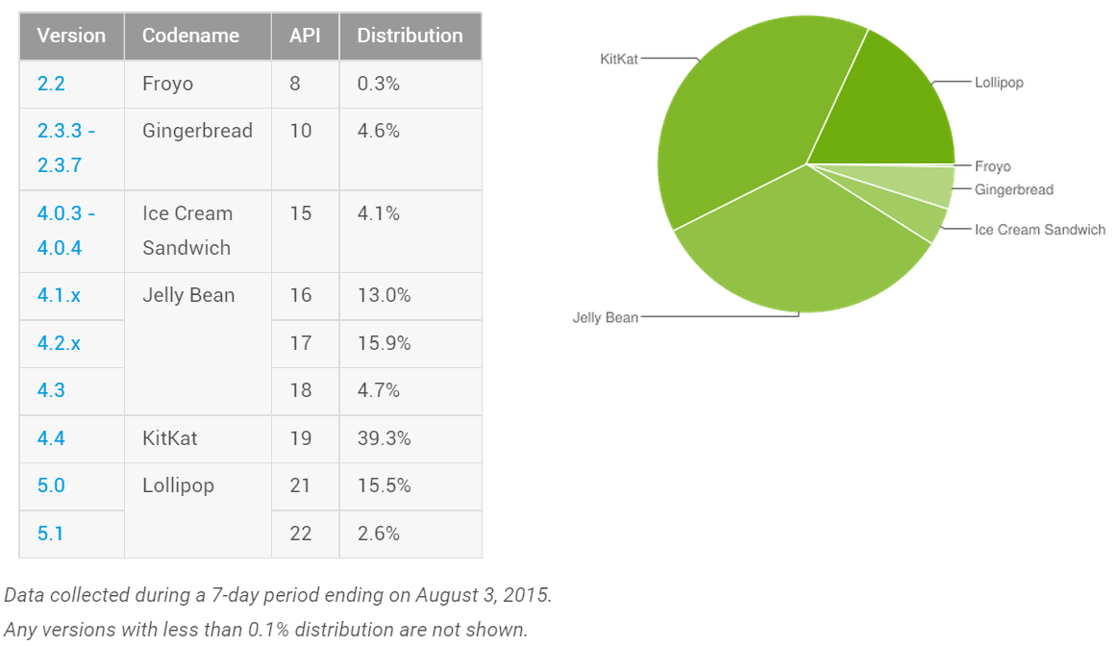
Android Distribution Aug 2015
https://developer.android.com/about/dashboards/index.html

Slide 7
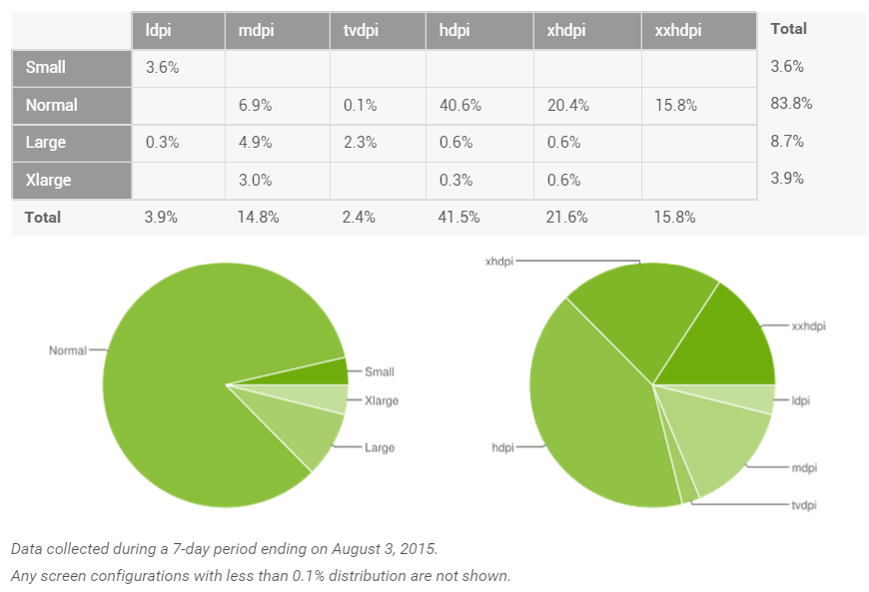
Screen Densities as of Aug 2015
~120dpi ~160dpi ~240dpi ~320dpi ~480dpi ~640dpi

Slide 8
Lets talk about Android Runtime!!!

Slide 9
Android Runtime – Dalvik VM
Subset of Java developed by Google
Optimized for mobile devices (better memory management, battery utilization, etc.)
Dalvik runs .dex files that are compiled from .class files
Introduces new libraries
Does not support some Java libraries like AWT, Swing
http://developer.android.com/reference/packages.html

Slide 10
Boxed Applications
By default, each app is run in its own Linux process
Process started when app’s code needs to be executed
Threads can be started to handle time-consuming operations
Each process has its own Dalvik VM
By default, each app is assigned unique Linux ID
Permissions are set so app’s files are only visible to that app

Slide 11

How to Produce a Android App?
Java code
javac
Byte code
Dalvik exe
dx
.java
.class
classes.dex
aapt
Byte code
<xml>
Other .class files
AndroidManifest.xml
.apk
<str>
Resources
Notes:
Every application must have an AndroidManifest.xml file (with precisely that name) in its root directory. The manifest presents essential information about the application to the Android system, information the system must have before it can run any of the application's code. Among other things, the manifest does the following:
It names the Java package for the application. The package name serves as a unique identifier for the application.
It describes the components of the application — the activities, services, broadcast receivers, and content providers that the application is composed of. It names the classes that implement each of the components and publishes their capabilities (for example, which Intent messages they can handle). These declarations let the Android system know what the components are and under what conditions they can be launched.
It determines which processes will host application components.
It declares which permissions the application must have in order to access protected parts of the API and interact with other applications.
It also declares the permissions that others are required to have in order to interact with the application's components.
It lists the Instrumentation classes that provide profiling and other information as the application is running. These declarations are present in the manifest only while the application is being developed and tested; they're removed before the application is published.
It declares the minimum level of the Android API that the application requires.
It lists the libraries that the application must be linked against.

Slide 12
Emulator

Slide 13
Emulator Basics
Host computer’s keyboard works
Host’s mouse acts as finger
Uses host’s Internet connection
Other buttons work: Home, Menu, Back, Search, volume up and down, etc.
Ctrl-F11 toggle landscape → portrait
Alt-Enter toggle full-screen mode
More info at http://developer.android.com/guide/developing/devices/emulator.html

Slide 14
Emulator Limitations
No support for placing or receiving actual phone calls
Simulate phone calls (placed and received) through the emulator console
No support for USB connections
No support for camera/video capture (input)
No support for device-attached headphones
No support for determining connected state
No support for determining battery charge level and AC charging state
No support for determining SD card insert/eject
No support for Bluetooth
No support for simulating the accelerometer
Use OpenIntents’s Sensor Simulator

Slide 15
Android Emulator (Android Virtual Device – AVD)
Emulator is essential to testing app but is not a substitute for a real device
Emulators are Android Virtual Devices (AVDs)
Android SDK and AVD Manager allows you to create AVDs that target any Android API level
AVD have configurable resolutions, RAM, SD cards, skins, and other hardware

Slide 16
Labs

Slide 17
Pre-Requisites
Install and Setup Android Studio following steps in the document attached
Add PDF and Point to Github

Slide 18

Agenda – What are you going to learn?
Create an Activity
Demonstrate resources created
Show the Activity lifecycle within the Android OS
Show the various debugging tools available
Show how to start one Activity from another

Slide 19
Lab1 – Create your first Android Hello World Application

Slide 20
Open Android Studio → Start New Project

Slide 21
Configure Android Project → Name your App

Slide 22
Select an Android SDK for your app to use

Slide 23
Add an Activity to your App

Slide 24
Create Main Activity – Name the Activity

Slide 25
Launch the App

Slide 26
Success!!! Yahoo!!

Slide 27
Lab2 – Add Code to Your App

Slide 28
Open HelloWorld Project → Java → MainActivity.java

Slide 29
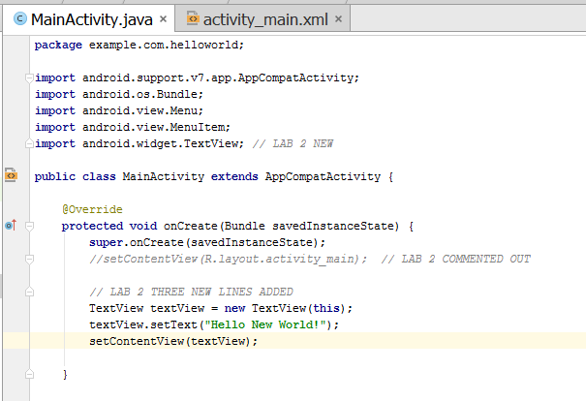
MainActivity.java

Slide 30
Update MainActivity.java
Add import android.widget.TextView;
In the OnCreate Method
Comment out THIS LINE // setContentView(R.layout.activity_main);
Add the lines
TextView textView = new TextView(this);
textView.setText("Hello New World!");
setContentView(textView);

Slide 31
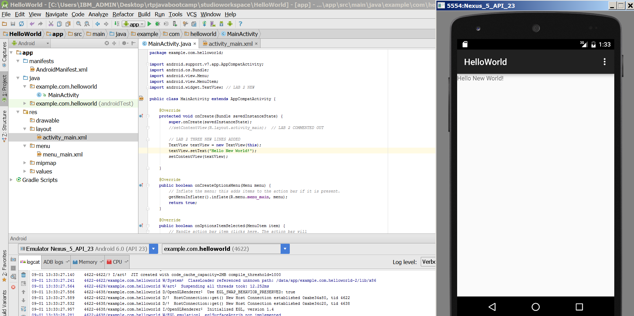
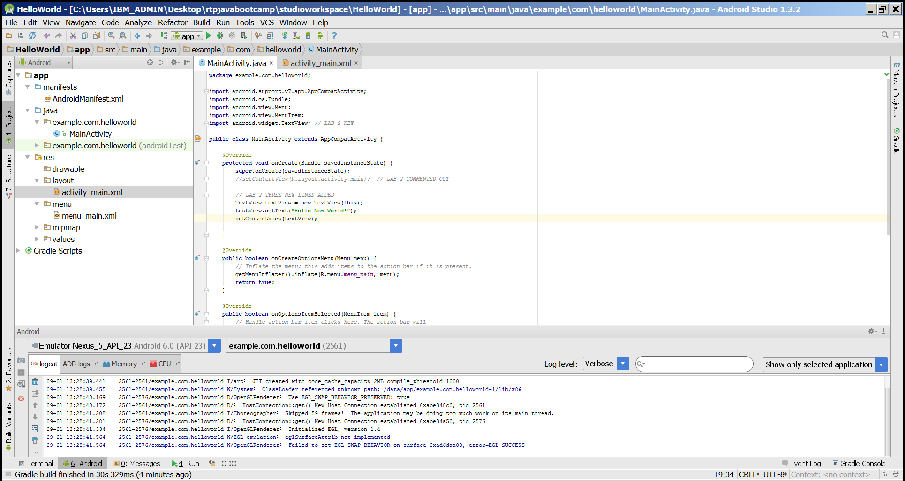
Launch Lab 2 – Hurray!

Slide 32
Lab3 – Log and View

Slide 33
Updated MainActivity.java – Screen shot

Slide 34
Update MainActivity.java
Add to Import
import android.util.Log;
ADD THESE LINES highlighted in green to OnCreate Method
Log.i(this.getClass().getName(), “TEXT1");
TextView textView = new TextView(this); // 3 lines already exists from lab2
textView.setText("Hello New World!");
setContentView(textView);
Log.i(this.getClass().getName(), “TEXT2");

Slide 35
Run and Check Log Filter – Verify the Messages

Slide 36
Lab4 – Induce an Error

Slide 37
Induce an Error in MainActivity.java - Screenshot

Slide 38
Induce an Error in MainActivity.java
ADD THESE LINES highlighted in green to onOptionsItemSelected method
int id = item.getItemId(); //noinspection SimplifiableIfStatement if (id == R.id.action_settings) { // ADD Lab 3 - Challenge !!! // LAB 4 CODE int i = 0; int j = 0; int k = i / j; return true; } return super.onOptionsItemSelected(item);

Slide 39
Run the App → To see the Error

Slide 40
Lab5 – Toasting

Slide 41
What is a Toast?
A toast provides simple feedback about an operation in a small popup. It only fills the amount of space required for the message and the current activity remains visible and interactive.

Slide 42
Modify MainActivity.java by adding Toast
Add to Import highlighted in green
import android.widget.Toast;
ADD highlighted in green to onOptionsItemSelected method
int id = item.getItemId(); //noinspection SimplifiableIfStatement if (id == R.id.action_settings) { Toast toast = Toast.makeText(this, "CLICKED SETTINGS !!!", Toast.LENGTH_LONG); toast.show();
REMOVE highlighted in green to onOptionsItemSelected method
// LAB 4 CODE //int i = 0; //int j = 0; //int k = i / j;

Slide 43
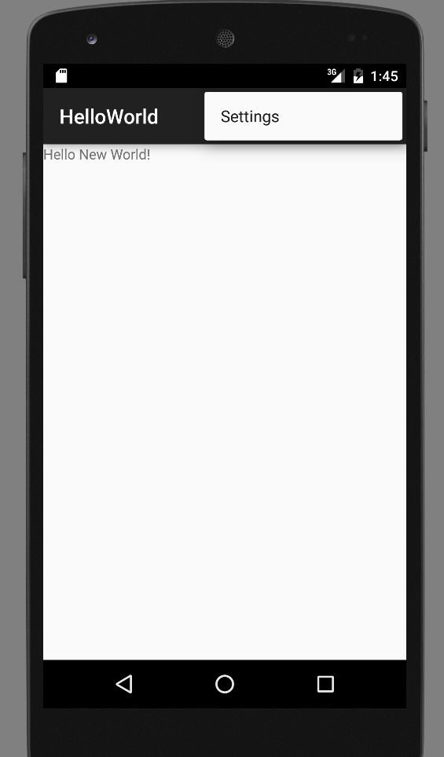
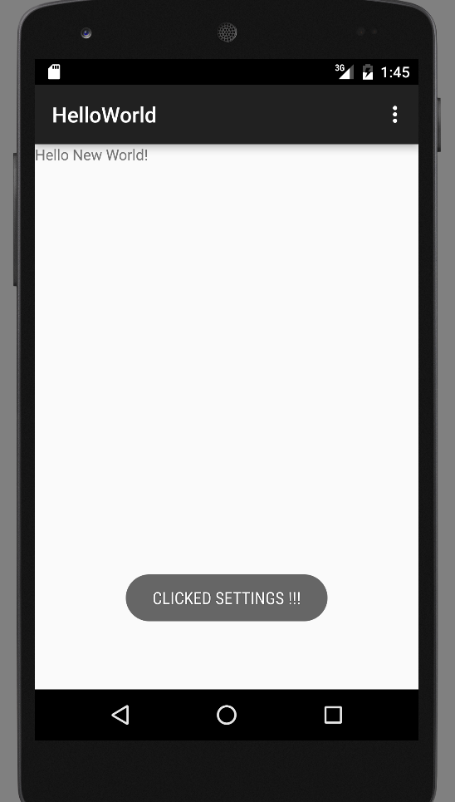
Run the App → View the Toast by clicking on settings (right hand corner)

Slide 44
Lab6 – Debugging

Slide 45
Add a Breakpoint → Run the app in Debug Mode

Slide 46
Debug Window

Slide 47
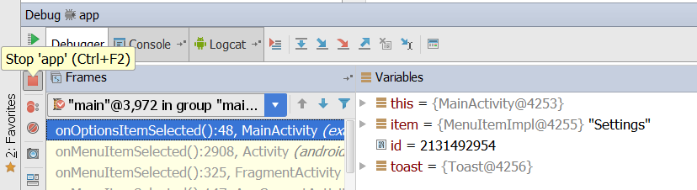
Stop the Debugger

Slide 48
Dalivik Debug Monitor Server (DDMS)
DDMS
debugging tool
"provides, screen capture on the device, thread and heap information on the device, logcat, process, and radio state information, incoming call and SMS spoofing, location data spoofing, and more."
can interact with DDMS via Eclipse plugin, another view in Android Studio

Slide 49
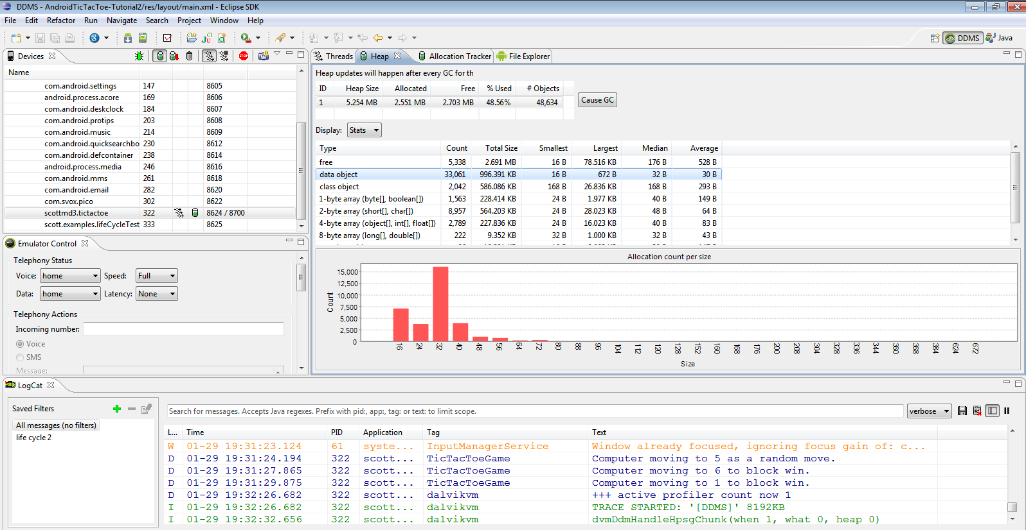
DDMS

Slide 50
Lab7 – Advanced

Slide 51
Create a New Project → Name it Lab7

Slide 52
SDK for Lab7 → Select SDK → Click Next

Slide 53
Complete Creating Project Lab7 → Click Finish

Slide 54
Open Activity_Main.xml → Add a Button to the screen → Select the button

Slide 55
Activity_Main.xml → Add a Button → Drag the button to the screen

Slide 56
Activity_Main.xml → Add a Button → Double Click on the Button and Name It → Submit

Slide 57
Add a Listener to Button → Create a Java Class → OurOnClickListener.java
Notes:
Add

Slide 58
Add onClick Method in OurOnClickListener.java → To Listen Submit Action in Mobile UI → Screenshot

Slide 59
Add onClick Method in OurOnClickListener.java → To Listen Submit Action in Mobile UI
package ecodcnc.com.lab7; import android.view.View; import android.view.View.OnClickListener; public class OurOnClickListener implements OnClickListener { MainActivity caller; private int count;
public OurOnClickListener(MainActivity activity) { this.caller = activity; this.count = 0; } @Override public void onClick(View v) { count++; String countstr = Integer.toString(count); caller.textView.setText("Clicked " + countstr + " times"); } }

Slide 60
Add onCreate Method in MainActivity.java → For Main Screen Submit Action Invocation (OurOnClickListener.java) → Screenshot

Slide 61
Add onCreate Method in MainActivity.java → For Main Screen Submit Action Invocation (OurOnClickListener.java)
package ecodcnc.com.helloandroid;
import android.app.Activity;
import android.os.Bundle;
import android.os.StrictMode;
import android.util.Log;
import android.view.Menu;
import android.view.MenuItem;
import android.widget.Button;
import android.widget.TextView;
import android.widget.Toast;
public class MainActivity extends AppCompatActivity {
TextView textView;
Button ourButton;
// OVER WRITE OnCreate Method in LAB 7
@Override
protected void onCreate(Bundle bundle) {
super.onCreate(bundle);
setContentView(R.layout.activity_main);
textView = (TextView) findViewById(R.id.textView);
ourButton = (Button) findViewById(R.id.button);
ourButton.setOnClickListener(new OurOnClickListener(this));
}

Slide 62
Run the Application

Slide 63
Hurray!!! My Submit Count App is Cool → Click on the Submit button and see the count increase

Slide 64
Important Files
src/MainActivity.java
Activity which is started when app executes
gen/R.java (DO NOT MODIFY!)
Auto-generated, auto-updated file with identifiers from main.xml, strings.xml, and elsewhere
res/layout/activity_main.xml
Defines & lays out widgets for the activity
res/values/strings.xml
String constants used by app
AndroidManifest.xml
Declares all the app’s components
Names libraries app needs to be linked against
Identifies permissions the app expects to be granted

Slide 65
Lab7 – Appendix

Slide 66
1 - src/MainActivity.java
package com.example.helloworld;
import android.support.v7.app.AppCompatActivity;
import android.os.Bundle;
import android.view.Menu;
import android.view.MenuItem;
public class MainActivity extends AppCompatActivity {
@Override
protected void onCreate(Bundle savedInstanceState) {
super.onCreate(savedInstanceState);
setContentView(R.layout.activity_main);
}
@Override
public boolean onCreateOptionsMenu(Menu menu) {
// Inflate the menu; this adds items to the action bar if it is present.
getMenuInflater().inflate(R.menu.menu_main, menu);
return true;
}
@Override
public boolean onOptionsItemSelected(MenuItem item) {
// Handle action bar item clicks here. The action bar will
// automatically handle clicks on the Home/Up button, so long
// as you specify a parent activity in AndroidManifest.xml.
int id = item.getItemId();
//noinspection SimplifiableIfStatement
if (id == R.id.action_settings) {
return true;
}
return super.onOptionsItemSelected(item);
}
}

Slide 67
2 - gen/R.java
Auto-generated file with identifiers from main.xml, strings.xml, and elsewhere
/* AUTO-GENERATED FILE. DO NOT MODIFY. * * This class was automatically generated by the * aapt tool from the resource data it found. It * should not be modified by hand. */ package com.example.helloworld; public final class R { public static final class anim { public static final int abc_fade_in=0x7f050000; public static final int abc_fade_out=0x7f050001; public static final int abc_grow_fade_in_from_bottom=0x7f050002; public static final int abc_popup_enter=0x7f050003; public static final int abc_popup_exit=0x7f050004; public static final int abc_shrink_fade_out_from_bottom=0x7f050005; public static final int abc_slide_in_bottom=0x7f050006; public static final int abc_slide_in_top=0x7f050007; public static final int abc_slide_out_bottom=0x7f050008; public static final int abc_slide_out_top=0x7f050009; } public static final class attr { /** <p>Must be a reference to another resource, in the form "<code>@[+][<i>package</i>:]<i>type</i>:<i>name</i></code>" or to a theme attribute in the form "<code>?[<i>package</i>:][<i>type</i>:]<i>name</i></code>".
Do not modify!

Slide 68
3 - res/layout/activity_main.xml
<RelativeLayout xmlns:android="http://schemas.android.com/apk/res/android"
xmlns:tools="http://schemas.android.com/tools" android:layout_width="match_parent"
android:layout_height="match_parent" android:paddingLeft="@dimen/activity_horizontal_margin"
android:paddingRight="@dimen/activity_horizontal_margin"
android:paddingTop="@dimen/activity_vertical_margin"
android:paddingBottom="@dimen/activity_vertical_margin" tools:context=".MainActivity">
<TextView android:text="@string/hello_world" android:layout_width="wrap_content"
android:layout_height="wrap_content"
android:id="@+id/textView" />
<Button
android:layout_width="wrap_content"
android:layout_height="wrap_content"
android:text="Submit"
android:id="@+id/button"
android:layout_below="@+id/textView"
android:layout_toRightOf="@+id/textView"
android:layout_toEndOf="@+id/textView"
android:layout_marginTop="68dp" />
</RelativeLayout>

Slide 69
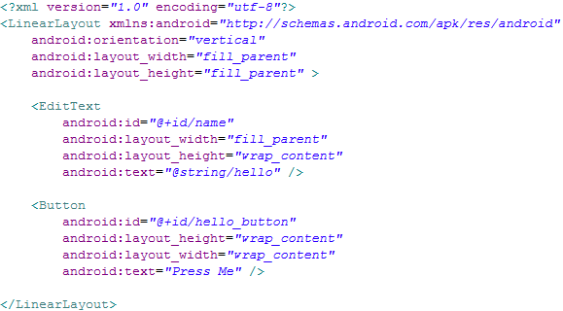
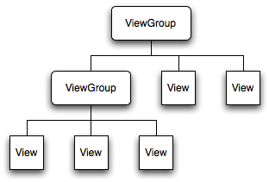
3 contd. - Understanding Layout
Declares layouts & widgets for the activity
Tree from: http://developer.android.com/guide/topics/ui/inex.html
Notes:
A ViewGroup is a special view that can contain other views (called children.) The view group is the base class for layouts and views containers. The ViewGroup subclass is the base class for layouts, which are invisible containers that hold other Views (or other ViewGroups) and define their layout properties. LinearLayout is a subclass of ViewGroup.
The View class represents the basic building block for user interface components. A View occupies a rectangular area on the screen and is responsible for drawing and event handling. View is the base class for widgets, which are used to create interactive UI components (buttons, text fields, etc.).

Slide 70
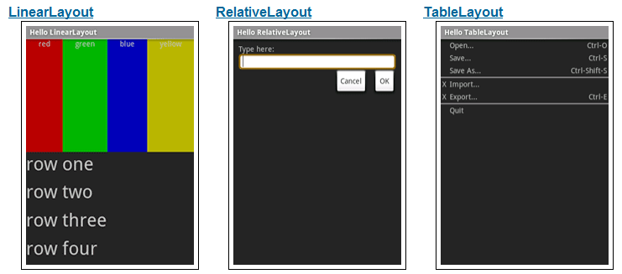
3 Contd - Available Layouts
http://developer.android.com/resources/tutorials/views/index.html

Slide 71
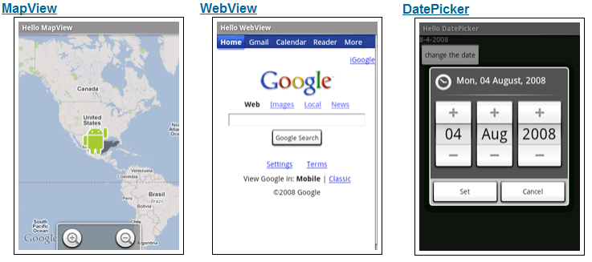
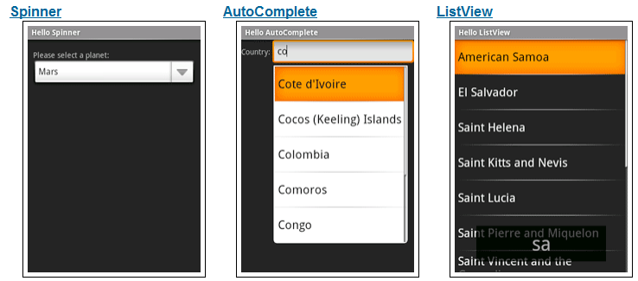
3 Layout and Available Widgets
http://developer.android.com/resources/tutorials/views/index.html

Slide 72
4 - res/values/strings.xml
String constants used by app
Used for supporting Localization
res/values-es/values/strings.xml to support Spanish
res/values-fr/values/strings.xml to support French
Etc.
<resources> <string name="app_name">HelloWorld</string> <string name="hello_world">Hello world!</string> <string name="action_settings">Settings</string> </resources>

Slide 73
5 - AndroidManifest.xml
Declares all the app’s components
Names libraries app needs to be linked against
Identifies permissions the app expects to be granted
<?xml version="1.0" encoding="utf-8"?> <manifest xmlns:android="http://schemas.android.com/apk/res/android" package="com.example.helloworld" > <application android:allowBackup="true" android:icon="@mipmap/ic_launcher" android:label="@string/app_name" android:theme="@style/AppTheme" > <activity android:name=".MainActivity" android:label="@string/app_name" > <intent-filter> <action android:name="android.intent.action.MAIN" /> <category android:name="android.intent.category.LAUNCHER" /> </intent-filter> </activity> </application> </manifest>
Notes:
This is the most common IntentFilter seen in Android applications. The action android.intent.action.MAIN indicates that this is the first activity that should be executed when starting this app. The category android.intent.category.LAUNCHER places this Activity in
the launcher window (the window that lists all the available apps).

Slide 74
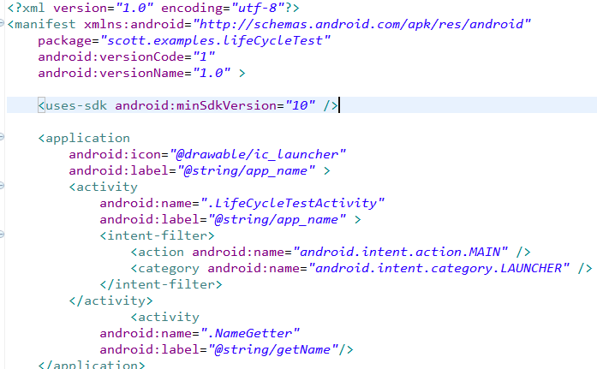
5 contd - AndroidManifest.xml
All Activities that are part of application must be registered in Manifest
Specify Activity to start with
Notes:
This is the most common IntentFilter seen in Android applications. The action android.intent.action.MAIN indicates that this is the first activity that should be executed when starting this app. The category android.intent.category.LAUNCHER places this Activity in
the launcher window (the window that lists all the available apps).

Slide 75
Some other topics covered
onCreate() in Activity
Adding Text and Changing Properties from Code
Use the log to v, d, i, w, e
VERBOSE, DEBUG, INFO, WARN, ERROR
Create a TAG so we can filter
Toast a message
Debug BreakPoint
ScreenShot of the APP
Adding component
Adding an Event and Setting Properties

Slide 76
Understanding the Essence of Lifecycle
Necessary to overload callback methods so you app behaves well:
App should not crash if the user receives a phone call or switches to another app while using your app.
App should not consume valuable system resources when the user is not actively using it.
App should not lose the user's progress if they leave your app and return to it at a later time.
App should not crash or lose the user's progress when the screen rotates between landscape and portrait orientation.
http://developer.android.com/training/basics/activity-lifecycle/starting.html

Slide 77
Understanding Activity Stack

Slide 78
Activity Stack
Most recently created is at Top
Activity 1
User currently interacting with me
Activity 2
Pressing Back or destroying A1 will bring me to the top
Activity 3
Activity N
If Activities above me use too many resources, I’ll be destroyed!

Slide 79
Typical Game
High Scores
Activity
Splash Screen
Activity
Main Menu
Activity
Game Play
Activity
Settings
Activity
Conder & Darcey (2010), Fig 4.1, p. 74

Slide 80
Starting Activities
Android applications don't start with a call to main(String[])
instead a series of callback methods are invoked
each corresponds to specific stage of the Activity / application lifecycle
callback methods also used to tear down Activity / application

Slide 81
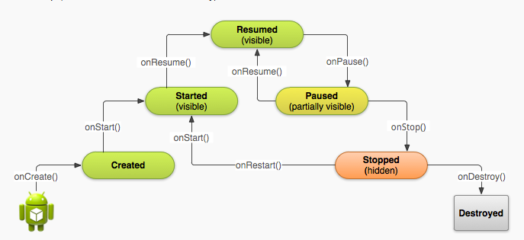
Simplified Lifecycle Diagram
ready to interact with user

Slide 82
Primary States
Active
activity is in the foreground and user can interact with it
Paused
activity partially obscured by another activity and user cannot interact with it (for example when working with a menu or dialog)
Stopped
activity completely hidden and not visible to user. It is in the background.
Activity instance and variables are retained but no code is being executed by the activity
Dead, activity terminated (or never started)
Two other states, Created and Started, but they are transitory onCreate -> onStart -> onResume

Slide 83
Application Components List
five primary components - different purposes
Activity
single screen with a user interface, app may have several activities, subclass of Activity
Most of early examples will be activities
Intents
used to pass information between applications
Service
Application component that performs long-running operations in background with no UI
example, an application that automatically responds to texts when driving

Slide 84
References
Android Dev Guide http://developer.android.com/guide/topics/fundamentals.html
http://developer.android.com/guide/topics/fundamentals/activities.html

Slide 85
Content Providers

Slide 86
Content Providers
Standard mechanism / interface to allow code in one process (app, content resolver) to access data from another process (app, content provider)
example, app to remind you to call certain people
content resolver accesses call log to check last contact
manage access to a structured set of data
encapsulate the data and provide mechanisms for defining data security

Slide 87
Content Provider - Content Resolver
Calendar App Data
Content Provider
Content Resolver
data
Your App
Content Resolver
Content Provider
Call Log Data
data

Slide 88
Content Providers
Many of the built in applications have content providers to allow other apps to access data
Examples of built in content providers
AlarmClock
CalendarContract (API level 14)
CallLog (sent and received calls)
ContactsContract
MediaStore (audio / visual data)
UserDictionary
VoicemailContract
many, many more
http://developer.android.com/reference/android/provider/package-summary.html

Slide 89
Content Providers
Provide access to a central data repository
ability to read and write to centralized data
data presented by Content Provider in the form of a table
like table from relational database
Each row in data table one "piece" of data in repository

Slide 90
Accessing Data
Use a ContentResolver client object in your app
ContentResolver communicates with ContentProvider
provides "CRUD" functionality, Create, Retrieve, Update, Delete
matching methods in Content Resolver / Content Provider
example: query() method
Create a cursor via content resolver to move through rows of table

Slide 91
Query
5 parameters
uri for content, URI
look at class documentation, generally a constant
projection, String[]
what columns to get from the table, null = all, inefficient
selection clause, String
filter, what rows to include, a SQL WHERE clause
selection args, String[]
replace ?'s in selection with these
sortOrder, String
how to order the rows

Slide 92
Cursor
The ContentResolver query method creates and returns a Cursor
Similar to a Database Cursor
similar to Scanner or Iterator
Move through the data (rows) one element at a time
Process data with loop or bind cursor to a ListView with an Adapter

Slide 93
Using Selection Criteria
Example gets rows in table
the selection criteria and selection args allow picking only certain rows
essentially an SQL WHERE clause
http://www.w3schools.com/sql/sql_where.asp
specify a criteria that must be met
? is value filled in with selectionArgs
multiple criteria possible, AND, OR, NOT

Slide 94
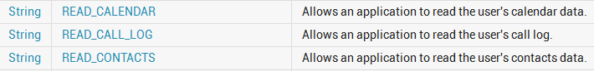
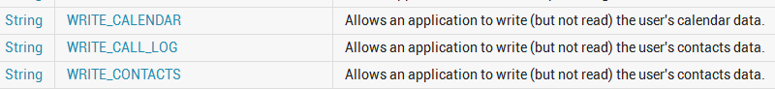
Permissions
Using certain content providers require an application request permission
so user aware what content the application will access and possibly modify

Slide 95
Contracts
Some apps that have content providers provide Contract classes
"help work with Content provider Uris, column names, intent actions, and other features of the content provider”
Adds a layer of abstraction and encapsulation

Slide 96
Lab8 – Content Providers

Slide 97
Create a New Project → Lab8 (Similar To Lab7) →Update activity_main.xml to build the screen layout
Copy the code from → https://github.com/ibmecod/mobile-androidintro/blob/master/Lab8/activity_main.xml→ activity_main.xml

Slide 98
Update MainActivity.java to invoke content providers
Copy the code from → https://github.com/ibmecod/mobile-androidintro/blob/master/Lab8/MainActivity.java → MainActivity.java

Slide 99
Run the Application → Create Contacts
Click on Contacts → Add Contacts
→

Slide 100
Run the Application
Click on New Button → Display all Contacts

Slide 101
Asynchronous Task (AsyncTask) in Android

Slide 102
AsyncTask
One of the most important problems in Android development is the User Interface (UI) responsiveness. Part of this is the fault of Android implementation, but much faults lies on the developer.
A key to a good GUI performance in Android development is to move as much work as possible off from the UI thread into the background. Using AsyncTasks is one of the easiest way to do this.
When to use AsyncTask?
An AsyncTask is designed to be a helper class around threads and handlers. As described in the Android documentation:
“AsyncTask enables proper and easy use of the UI thread. This class allows to perform background operations and publish results on the UI thread without having to manipulate threads and/or handlers.”
Simply said: An AsyncTask is used to do some computation in background and publish the result on the UI thread.

Slide 103
AsyncTask – Cont’d
AsyncTasks ideally are designed to perform operations in background which take at most a few seconds. It is not recommended to use them for downloading megabytes of data from servers or doing CPU intensive tasks, such as image processing.
If you want to keep threads running for a long period of time, it is strongly recommended to use Java threads or classes such as java.util.concurrent.Executor or java.util.concurrent.ThreadPoolExecutor in combination with android.os.Handler to publish the results on the UI thread.
Note : If you need to do network operations using either Java threads or AsyncTask. In Android 4 and above attempting to access the network from the UI thread will throw an exception.

Slide 104
AsyncTask – Life Cycle

Slide 105
AsyncTask – Life Cycle - Cont’d

Slide 106
AsyncTask – Usage
To use AsyncTask you must subclass it. An AsyncTask is started via the execute() method.
The execute() method calls the doInBackground() method.
AsyncTask is an intelligent thread that is recommended to be used. It is intelligent as it can help with it’s methods, and there are two methods that run on the UI thread, which is good to update UI components.
Use AsyncTask for:
Simple network operations which do not require downloading a lot of data
Disk-bound tasks that might take less than a few milliseconds

Slide 107
Lab9 - Click Counter Application Using AsyncTask

Slide 108
Click Counter Application – User Interface

Slide 109
Click Counter Application
MainActivity → New Button Click → Executing a counter in the background invoking an AsyncTask

Slide 110
Click Counter Application
onProgressUpdate → Display the progress of the counter in AysncTask → on the screen below the button

Slide 111
Run the Click Counter Application

Slide 112
Lab10 - HttpClientDemo

Slide 113
Http Client Demo Application – User Interface

Slide 114
HttpClientDemo Application - GET

Slide 115
HttpClientDemo Application - POST

Slide 116
HttpClientDemo Application – Parse RESPONSE (GET/POST)

Slide 117
Run HttpClientDemo Application

Slide 118
Lab11 – MobileUIFrontEnd-BluemixBackend

Slide 119
Android Mobile Application – Bluemix REST Service
Basic Application:
Create and Expose a Simple login REST Service, Searchtips Service in Bluemix
Create Simple UI Screens (Login, Search) and call REST Service in Bluemix

Slide 120
Create Login UI Interface
Notes:
120

Slide 121
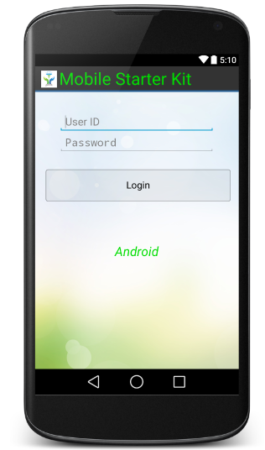
Add Activity to Login UI Interface → Button Event
Login UI → New Button Click → Define Button Event to trigger CheckLogin()
Notes:
121

Slide 122
Add Activity to Login UI Interface → CheckLogin()
Login UI → CheckLogin() → Triggers LoginTask passing the URL
Notes:
122

Slide 123
Define the REST URI and Messages for the Mobile App
Lab11 – MobileFrontEnd-BluemixBackend

Slide 124
LoginTask (AsyncTask) → Performs Post to REST URI
LoginTask → Invokes performpost (HttpPost) → URL
Notes:
124

Slide 125
Login UI → ReceiveResult from LoginTask
Login UI receives the results from LoginTask → Allows the user to next screen OR shows a validation error based on the credentials entered
Notes:
125

Slide 126
Create Search Interface
Notes:
126

Slide 127
Receive the task when complete
Step 1 : Receive the task and take necessary steps
In the project's java->com->ibm->startkit.android->view->LoginUI.java, locate the receiveResult() function
Copy the code from loginui.receive_result.code into this function
At this stage, we have a working UI that can execute a REST API via asynchronous task and take necessary action once the task in complete
Notes:
127

Slide 128
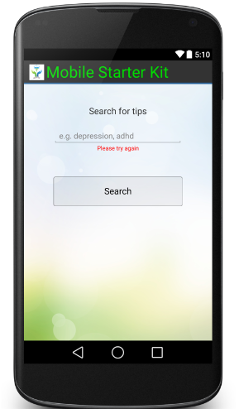
Make the Search Interface
Step 1 : Design the interface
Copy the code from searchui.xml.code to projects res->layout->searchui.xml
Step 2 : Set the content of the UI in LoginUI activity
In the project's java->com->ibm->startkit.android->view->apptasks->SearchUI.java, locate the onCreate() event and uncomment the necessary code.
Step 3 : Prepare the UI components and add some event to the interface's button even
In the project's java->com->ibm->startkit.android->view->apptasks->SearchUI.java, locate the setupUIComponents() function
Copy the code from searchui.setupUI.code into the setupUIComponents() function
Step 4 : Execute an asynchronous task to search for some tips
In the project's java->com->ibm->startkit.android->view->apptask->SearchUI.java, locate the doSearch() function
Copy the code from searchui.do_search.code into the doSearch() function
At this stage, we have an UI that calls an Aynchronous task but the task itself is not ready
Notes:
128

Slide 129
Define the Asynchronous task
Step 1 : Define the task
In the project's java->com->ibm->startkit.android->bluemix->SearchTipsTask.java, locate the performTask() function
Step 2 : Add some code to perform the remote API task
Copy the code from searchtipstask.perform_task.code into performTask() function
Do NOT forget to remove the “return null” from the function
At this stage, we have an interface that calls an Aynchronous task and the task can execute a server side via REST API
Notes:
129

Slide 130
Receive the task when complete
Step 1 : Receive the task and take necessary steps
In the project's java->com->ibm->startkit.android->view->apptasks->SearchUI.java, locate the receiveResult() function
Copy the code from searchui.receive_result.code into this function
At this stage, we have a working UI that can execute a REST API via asynchronous task and take necessary action once the task in complete
Notes:
130

Slide 131
Registering the interfaces
Step 1 : Manifests->AndroidManifest.xml
Copy the code from androidmanifest.activity_registration.code within the application tag
At this stage, we have a working application ready to be built and run
Confirm the “baseuri” value is correct in assets->starterkit.properties file
Notes:
131

Slide 132
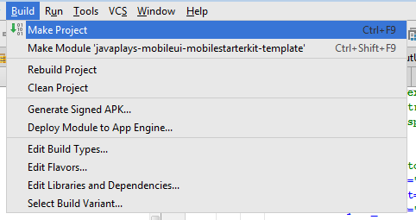
Build the Android Application
Building and running Android Application
Notes:
132

Slide 133
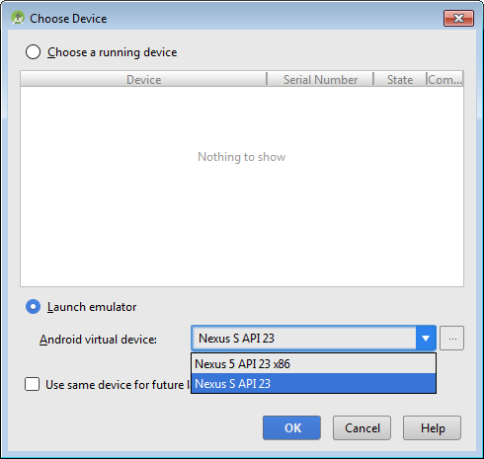
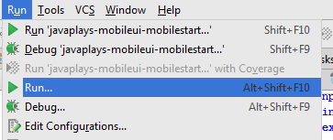
Run the Android Application
Running Android Application
Notes:
133

Slide 134
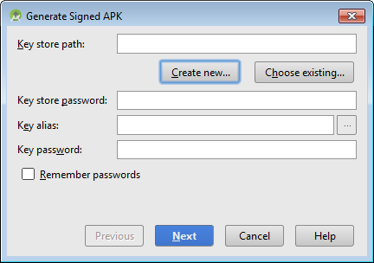
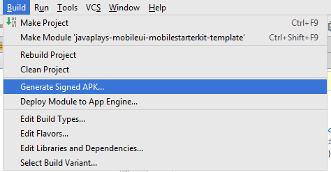
Generating an APK Signing an Android Application
From Build menu choose “Generate Signed APK
From the dialogue box, click Create New
If you already have a keystore, please choose the Choose Existing and provide the necessary password
Notes:
134

Slide 135
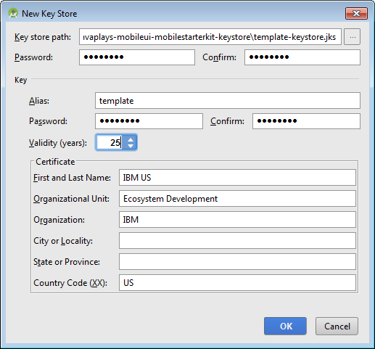
Generating an APK Signing an Android Application
Provide the Key Store Path
Provide the key
In this example every password is “template”
Notes:
135

Slide 136
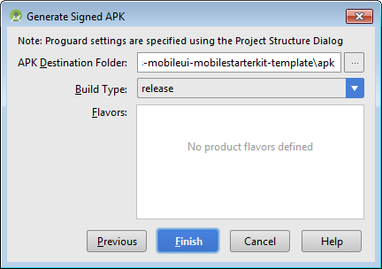
Signing an Android Application
Once successful, the wizard will ask for a destination
Click Finish
The process will confirm the generation of the APK
Now your application is ready to be released
Notes:
136

Slide 137
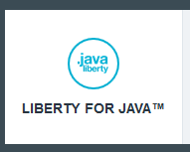
Task Execution Protocol – Step by step
S1 :
Activity creates the task and assigns an ID to it
Activity registers itself as a listener to the postExecution event of the task
Activity starts the task in a separate thread
S2 :
Task executes a POST method and waits for the result
S3 :
The response is received by the task thread
Task raises a postExecute() event and passes the response to any listener
S4 :
Activity responds to the event and process the result
S1
Task
Extends : AsyncServiceTask
S2
S4
S3
Activity
Implements : TaskReceiver
Notes:
137

Slide 138
Task Execution Protocol – Step by step
//SearchUI.java – if the user clicks the button
{
...
SearchTipsTask stt = new SearchTipsTask( ... );
stt.setReceiver(this);
stt.execute(_seeds);
...
}
//AsyncServiceTask.java
@Override
protected String doInBackground( String... params ) {
//performTask is implemented by the
//SearchTipsTask class
return performTask( params );
}
S1
S2
@Override
public void receiveResult( String response,
String source ) {
{
//make sure the task ID is the search task
if( source.equals( correct_id ) ){
//perhaps do something with the response
}
}
//AsyncServiceTask.java
@Override
protected void onPostExecute( String result ){
_response = result;
if( _tr != null ){
//calls the receiver's receiveResult function
//adds the serviceID here
//in this case the receiver is SearchUI.java
_tr.receiveResult( _response,_serviceID);
}
}
}
S3
S4
Notes:
138

Slide 139
How are all these stitched together? - without headache
com.ibm.android.asynctask.TaskReceiver - Interface
Every activity that required to use a REST API implements this class
This class enforces the activities to declare a receiveResult function
public interface TaskReceiver{
public void receiveResult( String response, String source );
}
String response
The response received from REST call
String Source
The ID of the asynchronous task generating the response
//Example : SearchUI.java
public void receiveResult( String response, String source ) {
//make sure the task ID is the search task
if( source.equals( SearchTipsTask._SEARCH_DOC_ID ) ){
//do something with the response
}
}
Notes:
139

Slide 140
How are all these stitched together? - without headache
com.ibm.android.asynctask.AsyncServiceTask - Abstract
Every task that calls REST API extends this class
This class enforces the tasks to define a REST API call
public abstract String performTask( String... params)
throws IOException, JSONException, URISyntaxException;
String... params
Input parameter needed for the task
//Example : SearchTipsTask
@Override
protected String performTask(String... params) throws IOException,
JSONException, URISyntaxException {
//retrieve the parameter
String keyword = params[0];
//POST and return the response
return performPost( ... );
}
Notes:
140

Slide 141
Lab12 – MobileUIFrontEnd-BluemixWatsonBackend

Slide 142
Extend Mobile Application – Using Full Power of Bluemix

Slide 143
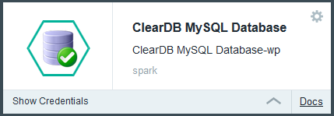
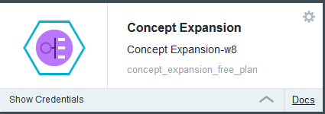
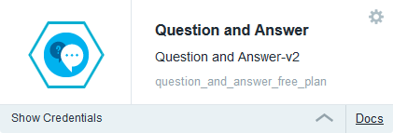
Light UI – Heavy Server side
Notes:
143

Slide 144
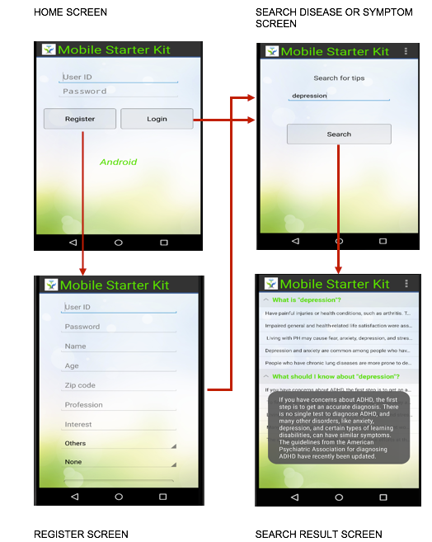
Mobile UI Flow

Slide 145
Task Execution Protocol – Step by step
S1 :
Activity creates the task and assigns an ID to it
Activity registers itself as a listener to the postExecution event of the task
Activity starts the task in a separate thread
S2 :
Task executes a POST method and waits for the result
S3 :
The response is received by the task thread
Task raises a postExecute() event and passes the response to any listener
S4 :
Activity responds to the event and process the result
S1
Task
Extends : AsyncServiceTask
S2
S4
S3
Activity
Implements : TaskReceiver
Notes:
145

Slide 146
Task Execution Protocol – Step by step
//SearchUI.java – if the user clicks the button
{
...
SearchTipsTask stt = new SearchTipsTask( ... );
stt.setReceiver(this);
stt.execute(_seeds);
...
}
S1
//AsyncServiceTask.java
@Override
protected String doInBackground( String... params ) {
//performTask is implemented by the
//SearchTipsTask class
return performTask( params );
}
S2
S3
@Override
public void receiveResult( String response,
String source ) {
{
//make sure the task ID is the search task
if( source.equals( correct_id ) ){
//perhaps do something with the response
}
}
S4
//AsyncServiceTask.java
@Override
protected void onPostExecute( String result ){
_response = result;
if( _tr != null ){
//calls the receiver's receiveResult function
//adds the serviceID here
//in this case the receiver is SearchUI.java
_tr.receiveResult( _response,_serviceID);
}
}
}
Notes:
146

Slide 147
How are all these stitched together? - without headache
com.ibm.android.asynctask.TaskReceiver - Interface
Every activity that required to use a REST API implements this class
This class enforces the activities to declare a receiveResult function
public interface TaskReceiver{
public void receiveResult( String response, String source );
}
String response
The response received from REST call
String Source
The ID of the asynchronous task generating the response
//Example : SearchUI.java
public void receiveResult( String response, String source ) {
//make sure the task ID is the search task
if( source.equals( SearchTipsTask._SEARCH_DOC_ID ) ){
//do something with the response
}
}
Notes:
147

Slide 148
How are all these stitched together? - without headache
com.ibm.android.asynctask.AsyncServiceTask - Abstract
Every task that calls REST API extends this class
This class enforces the tasks to define a REST API call
public abstract String performTask( String... params)
throws IOException, JSONException, URISyntaxException;
String... params
Input parameter needed for the task
//Example : SearchTipsTask
@Override
protected String performTask(String... params) throws IOException,
JSONException, URISyntaxException {
//retrieve the parameter
String keyword = params[0];
//POST and return the response
return performPost( ... );
}
Notes:
148

